Slide 1

Deliverable 4 is the Concept Generation and Selection.

Slide 2

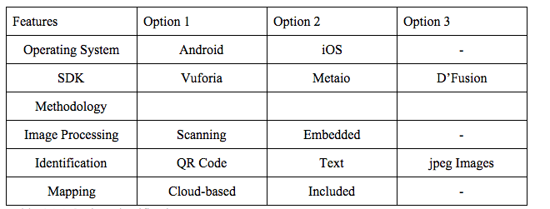
Concept Generation Chart
SDK | Vuforia | Metaio | D’Fusion
Brainstorming portion of the project

Slide 3
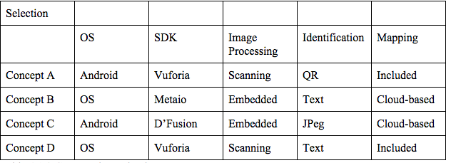
We combined the options brainstormed in different ways to generate concept ideas.

Slide 4
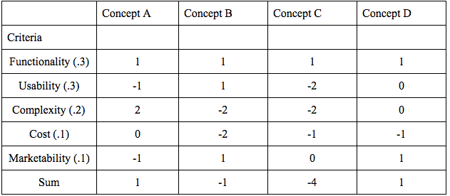
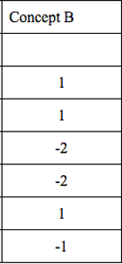
The next step was to score the concepts based on objectives.

Slide 5
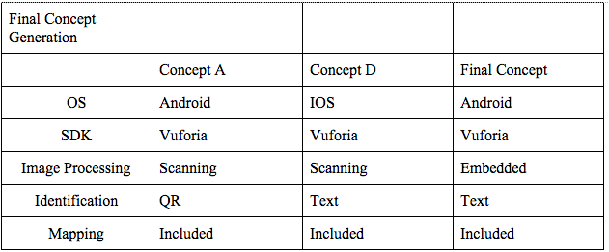
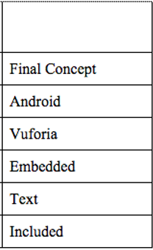
Because of the tie, we generated a final concept based on both of them combined.

